Slide 1
Used Cars Price Prediction
Name: 徐铂凯 Michael
ID: 1730014072

Slide 2
Table of Contents
1. Introduction and Related Works
2. Explorative Data Analysis (EDA)
3. Methodology and Results
4. Conclusion

Slide 3
Introduction and Related Works
Due to the increased price of new cars and the incapability of customers to buy new cars, used cars sales are on a global increase. There is a need for a used car price prediction system to effectively determine the worthiness of the car using a variety of features.
Linear Models[1] [2] like Linear Regression, Random Forest[3], and back propagation Neural Network [4].

Slide 4
Explorative Data Analysis (EDA)

Slide 5
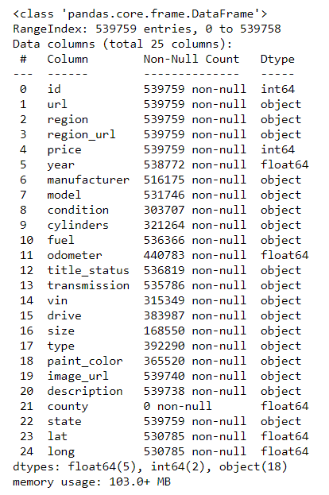
Dataset and Features
25 Columns with 1 target variable price, totally 539,759 entries

Slide 6
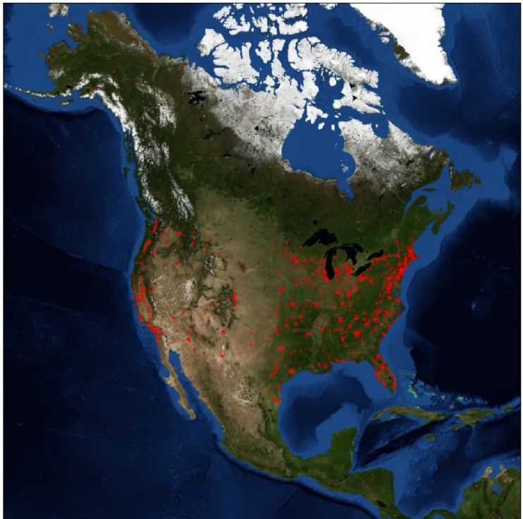
Locations
50,000 samples
Red points in the figure represent 1 used car’s location.
All the used cars in this dataset are in USA

Slide 7
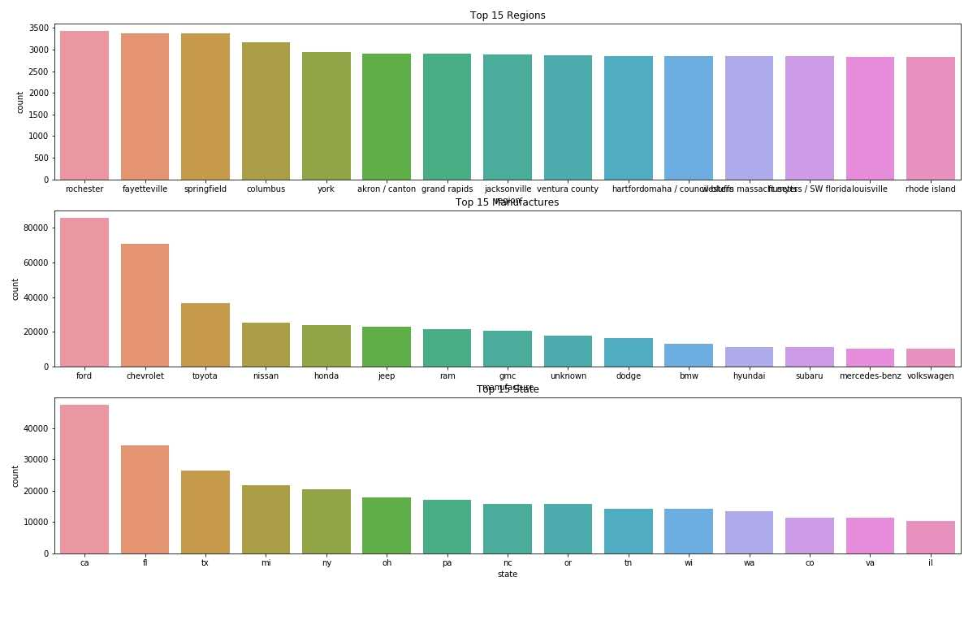
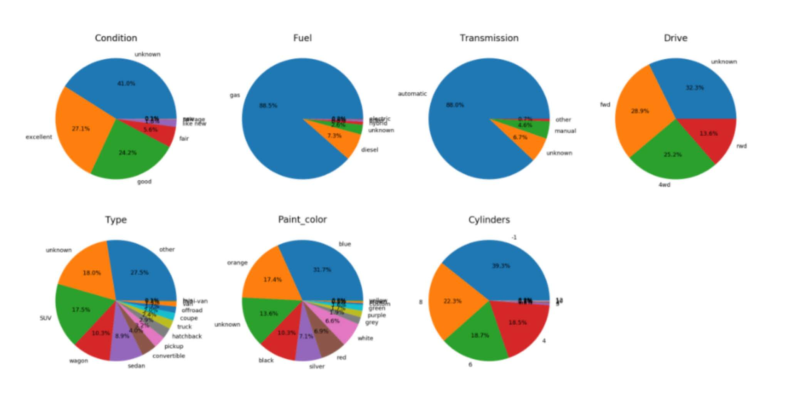
Attributes
Percentage of Different values in Different Categorical Attributes
Top 15 Regions, Manufacture and States
Preprocessing:
Years between 1960 and 2019
Fill the unknown or missing values with unknown or -1
Sales of Used Car in Each Year

Slide 8
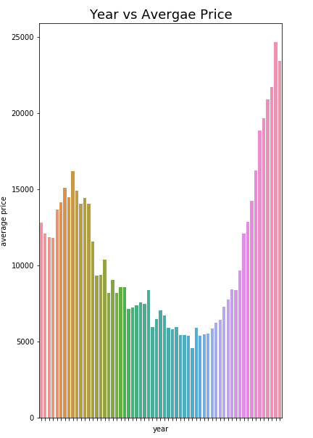
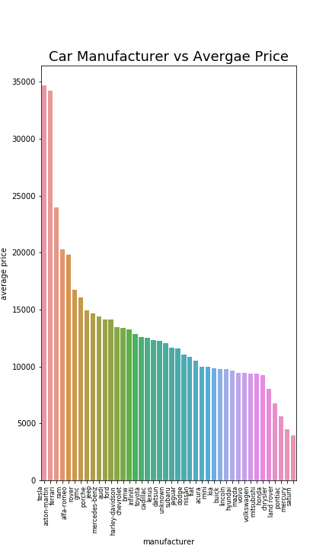
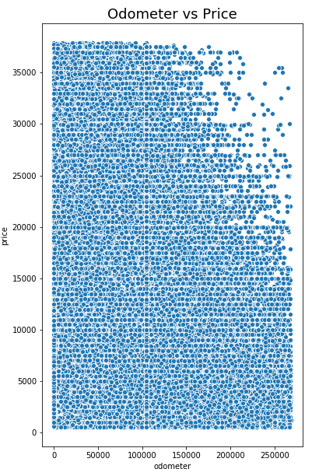
Relations
Relations between odometers and price, year and average price, and manufacture and
average price respectively from left to right.

Slide 9
Methodology and Results

Slide 10
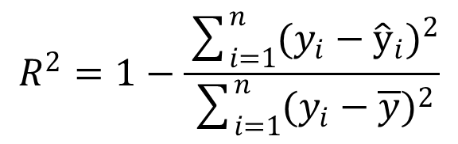
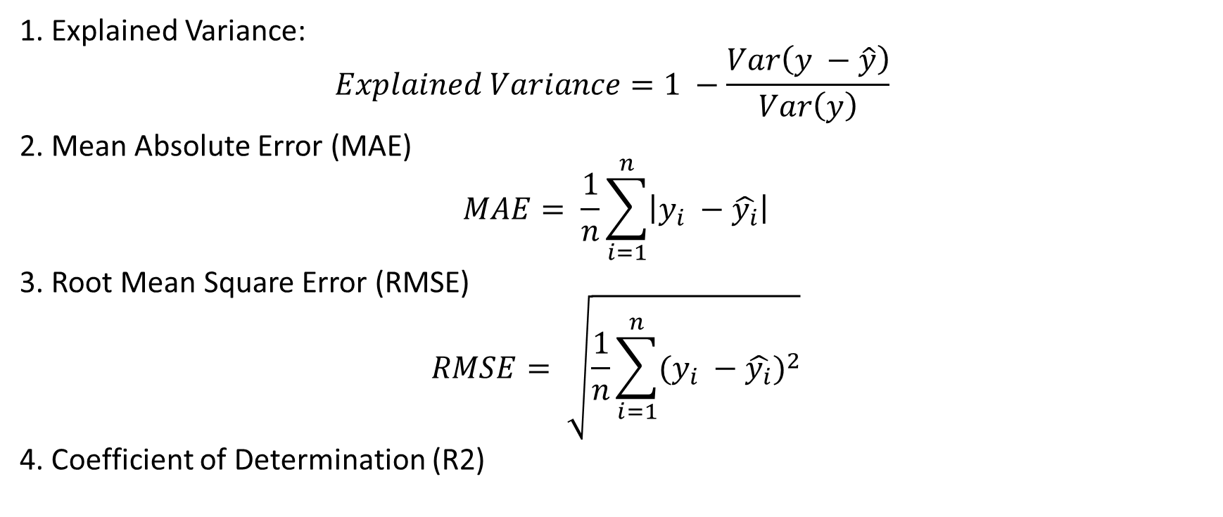
Evaluation Indexes
1. Explained Variance:
$$Explained Variance=1 −\frac{Var\left(y −\hat{y}\right)}{Var\left(y\right)}$$
2. Mean Absolute Error (MAE)
$$MAE= \frac{1}{n}\sum_{i=1}^{n}{\left|y_{i} −\hat{y_{i}}\right|}$$
3. Root Mean Square Error (RMSE)
$$RMSE= \sqrt{\frac{1}{n}\sum_{i=1}^{n}{{(y_{i} −\hat{y_{i}})}^{2}}}$$
4. Coefficient of Determination (R2)
$$R^{2}=1−\frac{\sum_{i=1}^{n}{{(y_{i}−{\hat{y}}_{i})}^{2}}}{\sum_{i=1}^{n}{{(y_{i}−\overline{y})}^{2}}}$$

Slide 11
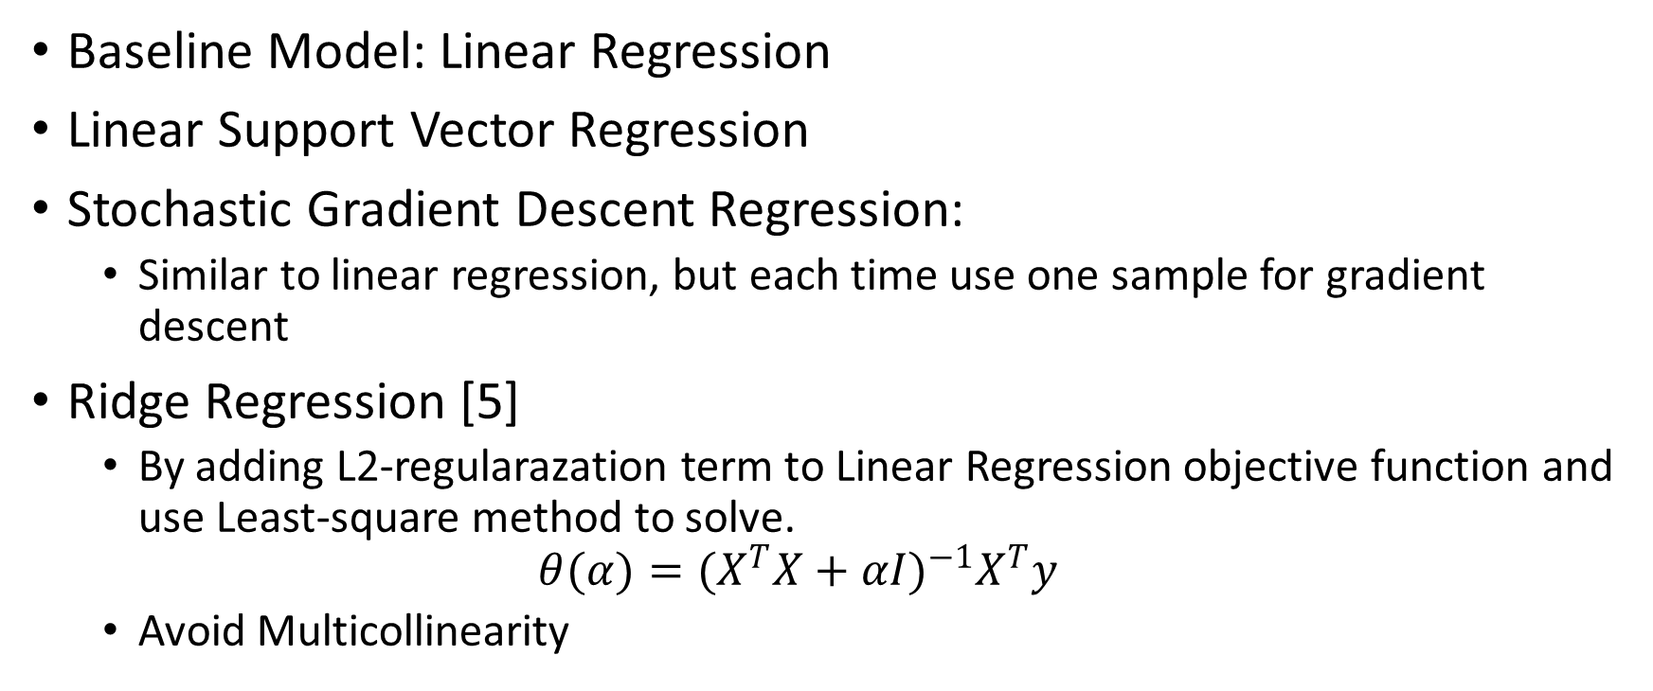
Linear Models
Baseline Model: Linear Regression
Linear Support Vector Regression
Stochastic Gradient Descent Regression:
Similar to linear regression, but each time use one sample for gradient descent
Ridge Regression [5]
By adding L2-regularazation term to Linear Regression objective function and use Least-square method to solve.
$$θ(α)={(X^{T}X+αI)}^{−1}X^{T}y$$
Avoid Multicollinearity

Slide 12
Linear Models
Results
Scores for Training Set
Scores for Testing Set

Slide 13
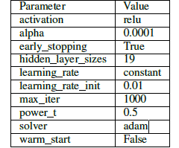
Neural Network
Multiple Layer Perceptron Regressor
Similar with Linear Regression, with slightly difference by using activation functions instead of just output the results.
By using grid search method for training 70 minutes, get the following parameters:

Slide 14
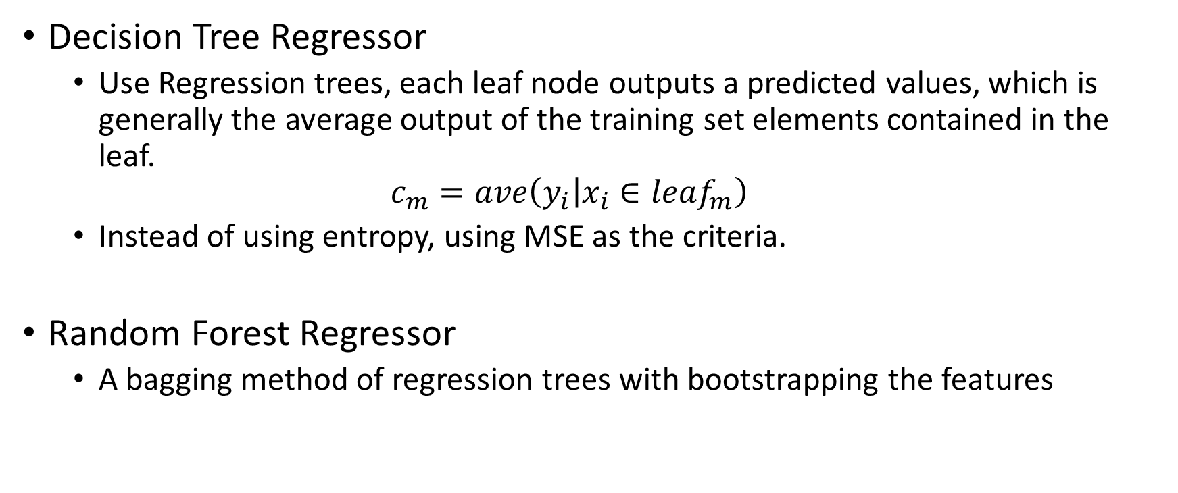
Tree-based Models
Decision Tree Regressor
Use Regression trees, each leaf node outputs a predicted values, which is generally the average output of the training set elements contained in the leaf.
$$c_{m}=ave\left(y_{i} | x_{i}∈leaf_{m}\right)$$
Instead of using entropy, using MSE as the criteria.
Random Forest Regressor
A bagging method of regression trees with bootstrapping the features

Slide 15
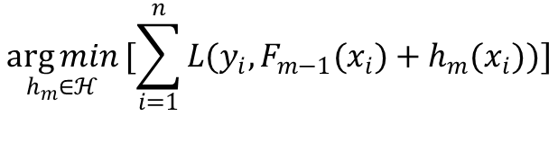
Tree-based Models
Observed: 30
Gradient Boosting [6]
Intuitively understanding, there is a residual difference between the prediction and the actual value in each iteration. The prediction is carried out in the next iteration according to the residual. And finally, all the predictions are added up to get the result.
Objective function:
30
Predict
16
Calculate residual
14
Predict
8
Calculate residual
6
Predict
5
Calculate residual
1
Predict
1
$$\underset{h_{m}∈ℋ}{\arg{min}}[\sum_{i=1}^{n}{L(y_{i},F_{m−1}(x_{i})+h_{m}(x_{i}))}]$$
Add up 1 + 5 + 8 + 16 = 30

Slide 16
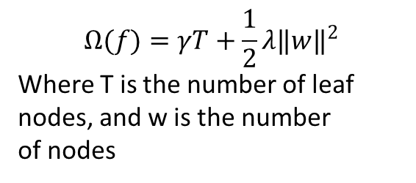

Tree-based Models
eXtreme Gradient Boosting (XGBoost) [7]
Based on Gradient Boosting, adding the regularization and model complexity term. Objective function:
$$\underset{h_{m}∈ℋ}{\arg{min}}[\sum_{i=1}^{n}{L\left(y_{i},F_{m−1}\left(x_{i}\right)+h_{m}\left(x_{i}\right)\right)}+\sum_{k}{Ω(f_{k})}]$$
$$Ω(f)=γT+\frac{1}{2}λ‖w‖^{2}$$
Where T is the number of leaf nodes, and w is the number
of nodes
Many enhancements like parallel calculations and hardware optimization.

Slide 17
Tree-based Models
Decision Tree | 4 minutes
Random Forest | 18 minutes
Gradient Boosting | 25 minutes
XGBoost (with GPU Acceleration) | 3 minutes
Results
Use grid search and cross validation methods to find the best estimator (see in report).
2. Overfitting Problem
Possible reasons: Tree models cannot predict values that out of the range of target values in the training dataset, that is, they can only do interpolation, not extrapolation.
Training set scores
Testing set scores

Slide 18
Ensemble Learning
Bagging
Bootstrap aggregating (Bagging), is a machine learning ensemble meta-algorithm designed to improve the stability and accuracy of machine learning algorithms used in statistical classification and regression.
It also reduces variance and helps to avoid overfitting.
AdaBoost
An AdaBoost regressor is a meta-estimator that begins by fitting a regressor on the original dataset and then fits additional copies of the regressor on the same dataset but where the weights of instances are adjusted according to the error of the current prediction.

Slide 19
Ensemble Learning
Stacking
MLP
Linear Regression
SGD regression
Random Forest
Ridge Regression
Bagging
19

Slide 20
Ensemble Learning
Results
Training set scores
Testing set scores

Slide 21
Conclusion
In conclusion, I have compared different models based on 4 evaluation indexes. And some models perform quite well. In the future, I will try some methods like early stopping and data augmentation to avoid overfitting problems. Also, I will try some deep neural models to find whether deep learning can apply to my dataset or not.

Slide 22
Thank you for listening

Slide 23
References
[1] N. Monburinon, P. Chertchom, T. Kaewkiriya, S. Rungpheung, S. Buya, and P. Boonpou, “Prediction of prices for used car by using regression models,” in 2018 5th International Conference on Business and Industrial Research (ICBIR). IEEE, 2018, pp.115–119.
[2] M. Listiani, “Support vector regression analysis for price prediction in a car leasing application,” Ph.D. dissertation, Citeseer, 2009.
[3] N. Pal, P. Arora, P. Kohli, D. Sundararaman, and S. S. Palakurthy, “How much is my car worth? a methodology for predicting used cars’ prices using random forest,” in Future of Information and Communication Conference. Springer, 2018, pp. 413–422.
[4] S. Gongqi, W. Yansong, and Z. Qiang, “New model for residual value prediction of the used car based on bp neural network and nonlinear curve fit,” in 2011 Third International Conference on Measuring Technology and Mechatronics Automation, vol. 2. IEEE, 2011, pp. 682–685.
[5] A. E. Hoerl and R. W. Kennard, “Ridge regression: Biased estimation for nonorthogonal problems,” Technometrics, vol. 12, no. 1, pp. 55–67, 1970.
[6] J. H. Friedman, “Greedy function approximation: a gradient boosting machine,” Annals of statistics, pp. 1189–1232, 2001.
[7] T. Chen and C. Guestrin, “Xgboost: A scalable tree boosting system,” in Proceedings of the 22nd acm sigkdd international conference on knowledge discovery and data mining, 2016, pp. 785–794.

